Slide 1
CUPED
Controlled experiment Using Pre Experiment Data
Original Paper : Link

Slide 2

Why CUPED matters
In online experiments, CUPED decreases variability of your treatment variable and as a result increases power of your test
Why do we care?
Small effect → Large $ Impact
Shorter wait times → Faster innovation

Slide 3





Finding an Unbiased Metric with lower variance
Unbiased Estimator
Y: The metric of interest measured during the experiment.
X: The same (or a related) metric measured during the pre-experiment period. (Constant)
Compute Variance of Estimator
Optimize for Theta

Slide 4




Variance of CUPED metric is minimized when correlation between Metric and Covariate is maximized
Substitute theta* into variance expression and simplify
Express variance in terms of Correlation Coefficient

Slide 5
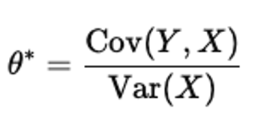
CUPED in Practice
Calculate the scaling factor θ from the covariance between the experiment metric and the pre-experiment metric.
2. Adjust the metric using the CUPED formula.
3. Perform subsequent analysis on the adjusted metric.

Slide 6
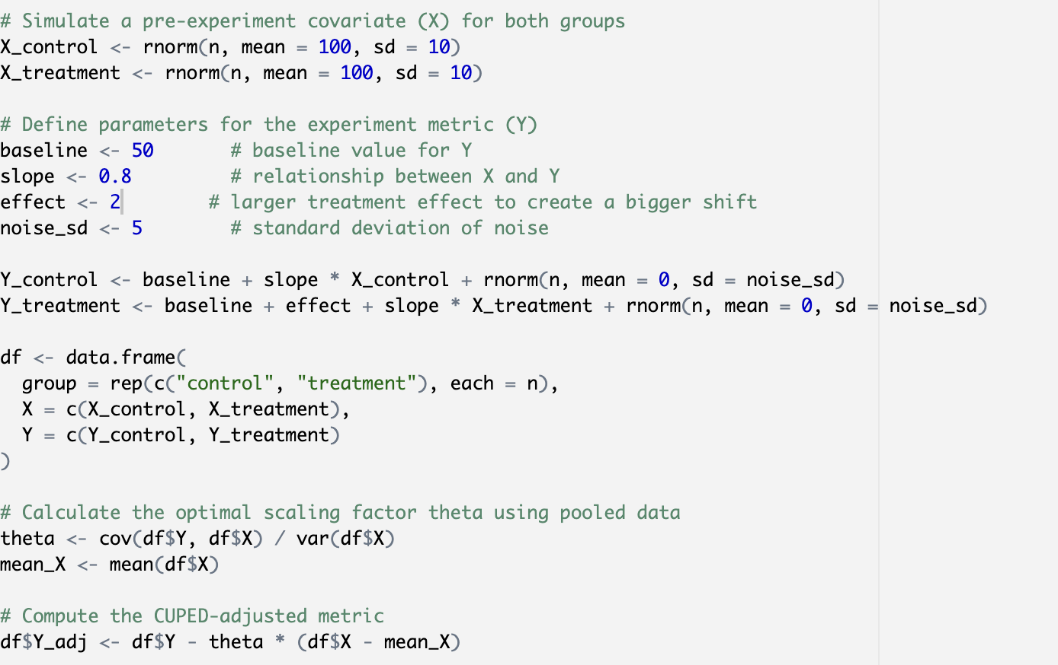
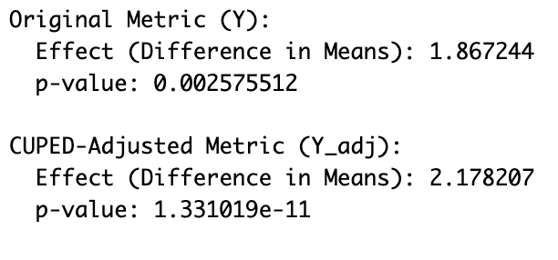
Effect estimation is stable but p value decreases

Slide 7
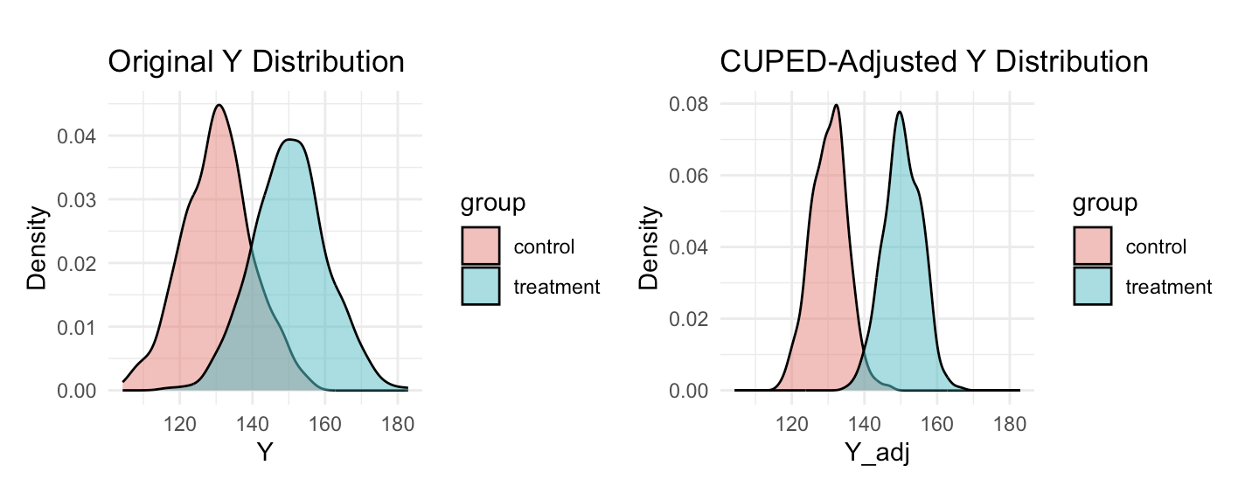
Controlling for Covariates decreases variance and increases power
(effect increased to 20)

Slide 8
Appendix

Slide 9
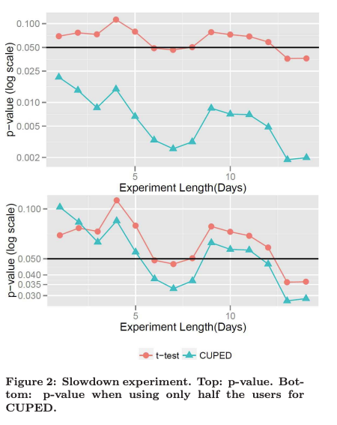
Example from Microsoft Paper

